Slide 1
Principles of Programming Language
Radha Krishna B - 2020801013

Slide 2
DSL to generate SQL SELECT Statements
Problem:
As we can see that the retail stores across use a sophisticated UI to get the details from the current warehouse and all of these from the UI inputs try to run the SQL statements on the database that is present in the local or the cloud storage. We would want to solve this by having a simpler UI and a language that can be inhibited to the user which is like talking to the warehouse directly and this language on the input from the user can generate the SQL SELECT statements to search to the warehouse.

Slide 3
DSL to generate SQL SELECT Statements
Need:
No as we see that the SQL statements to be written by a non tech user is never easy and even if we teach the simple statements to them and try to ask them to run it, it will be difficult to give access of the database to the non tech user which will put the security aspect of database in the risk.
Now the sophisticated UI in general to use by the user leaves the user with bunch of options and learning to be given. Now instead if we can provide them a language to communicate with the database as if they are communicating with a person it will be much easier and faster.

Slide 4
DSL to generate SQL SELECT Statements
Assumptions:
The user who is using our system will be given the access to set of columns that are present in the database. These columns will also be a part of the initial environment of our DSL
Concrete Syntax :
e := <expression> |
<expression> ( <expression> <realop> <num> ) | <expression> ( <expression> <realop> <string> ) |
<expression> ( ( <expression> <realop> <num>) <logicalop> ( <expression> <realop> <num> ) ) |
<expression> ( ( <expression> <realop> <num>) <logicalop> ( <expression> <realop> <string> ) )
<logicalop> := (AND , OR)
<relaop> := (>,<,>=,=,<=,!=) (if successor is <num>)
( = , != ) (if successor is <string>)

Slide 5
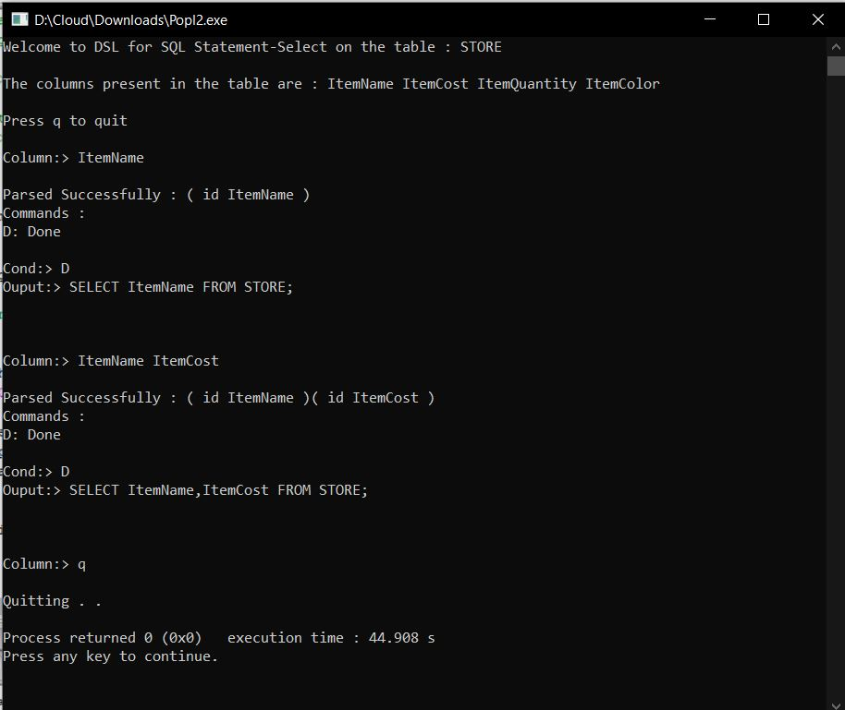
Snippets
If we have only the columns :
Single Column
Multiple Columns

Slide 6
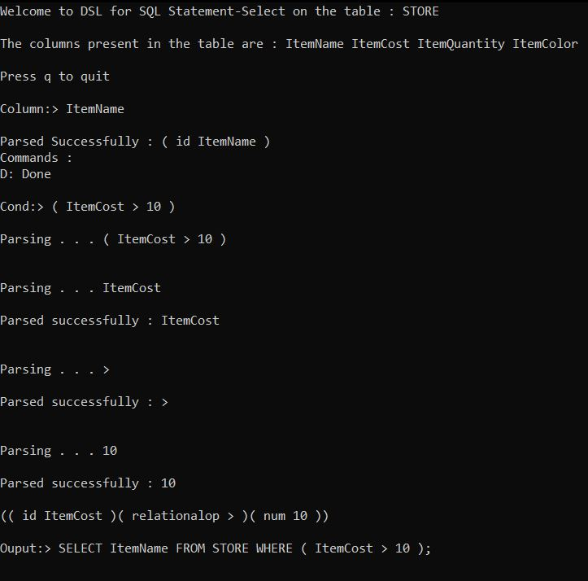
Snippets
If we want to select columns
with a condition :
Relational Conditions
Error Checking

Slide 7
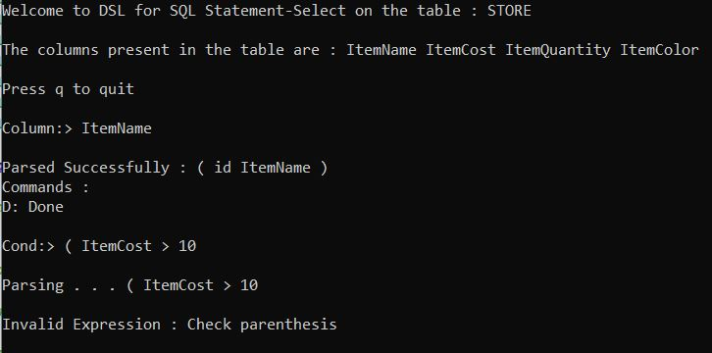
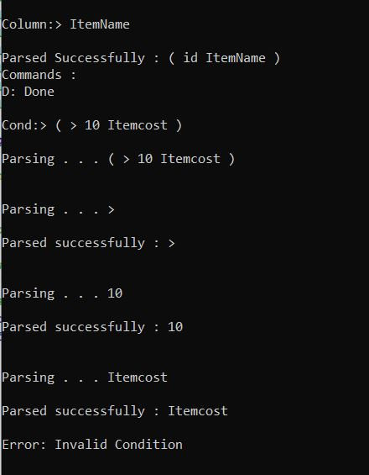
Snippets
If we want to select columns
with a condition :
Relational Conditions
Error Checking

Slide 8
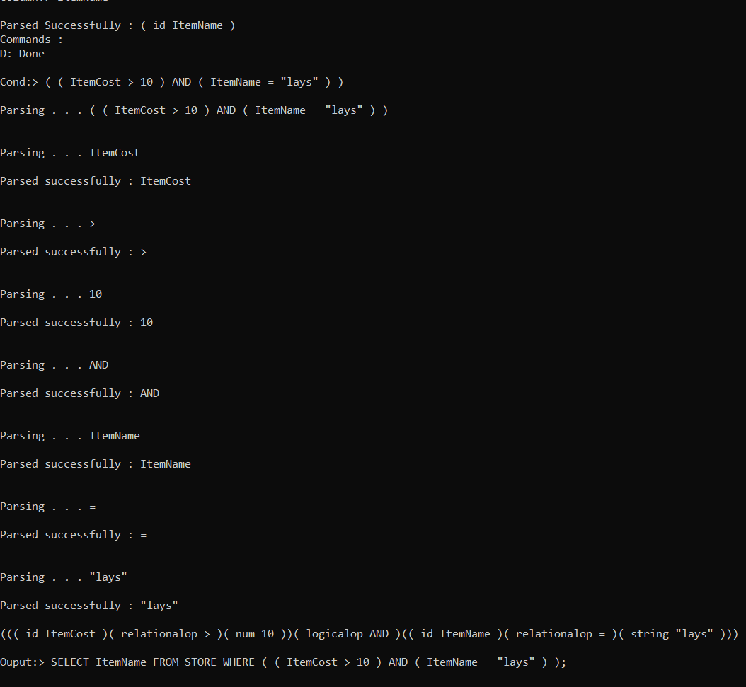
Snippets
If we want to select columns
with multiple conditions using logical
operators AND/OR:
AND
OR

Slide 9
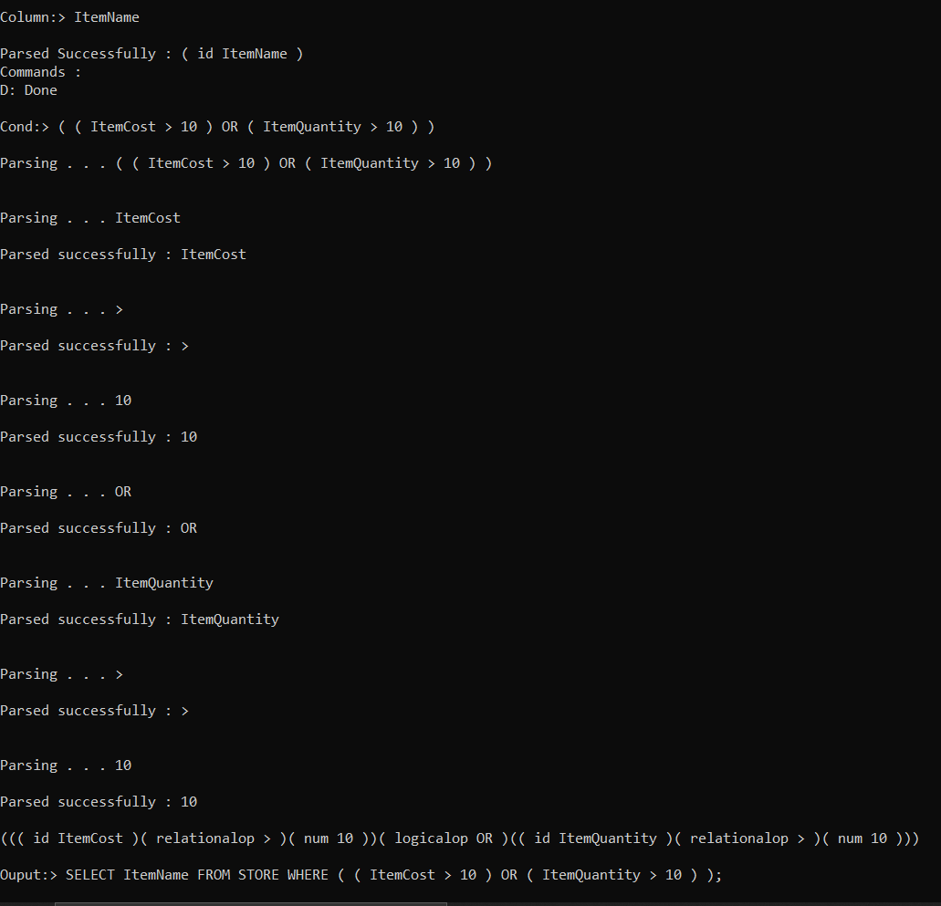
Snippets
If we want to select columns
with multiple conditions using logical
operators AND/OR:
AND
OR

Slide 10
—------------------------------

